Slide 1
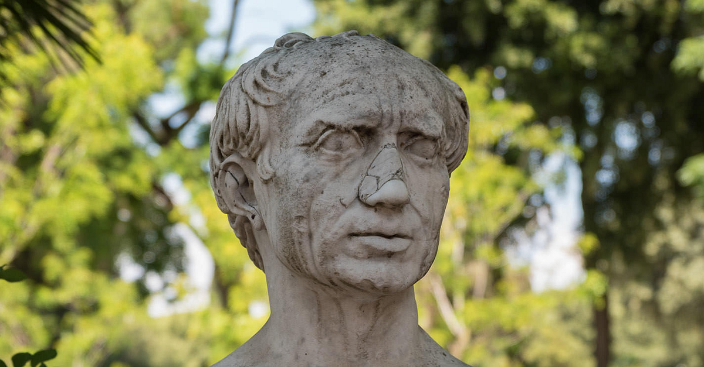
Topic: Rome, the Late Republic to the Lex Manilia
c. 133-66 BC
Year 12 Unit 3: Societies and Change
Gaius Marius

Slide 2
Tiberius’s Death
In the decades following Tiberius’s death, political factions began to emerge among the aristocrats
The key factions concerned with keeping political power were the populares and optimates
Both factions were different in their preferred methods of gaining this power

Slide 3
Key Terms
Populares:
Political faction that believed success could be achieved by working with people
Optimates:
Latin for ‘best men’; a political faction that included most of the aristocracy.
They wanted to maintain traditional Roman values and the power of the Senate

Slide 4
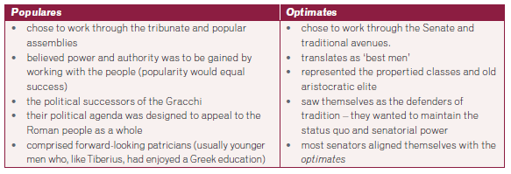
Comparing Approaches to Maintaining Power in Rome

Slide 5
Timeline of Conflicts
100 BCE: a slave uprising involving 30,000 slaves in Italy
112 – 106 BCE: Jugurthine War in Numidia
113 – 101 BCE: Wars against the Cimbri and Teutones in Cisalpine Gaul and Gallia Narbonensis
91 – 88 BCE: The Social Wars

Slide 6
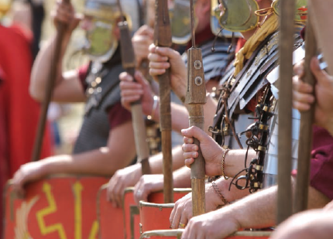
Conflicts
These conflicts placed continual pressure on the Republic and made heavy demands on resources, both people and finances
Emergence of powerful generals who could build a strong army became the backbone of the Roman Empire
Re-enactment of Roman Soldiers

Slide 7
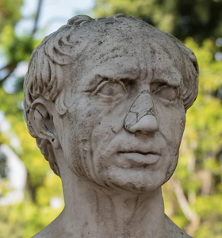
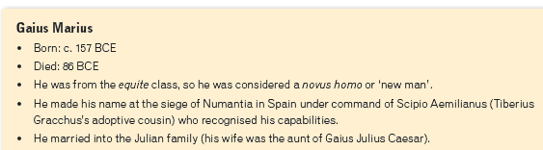


Gaius Marius
Source 1: Plutarch, 75 BCE, Life of Marius, Book 2.1
Source 2: Sallust, c. 41-40 BCE, The Jugurthine War, Chapter 63.6

Slide 8
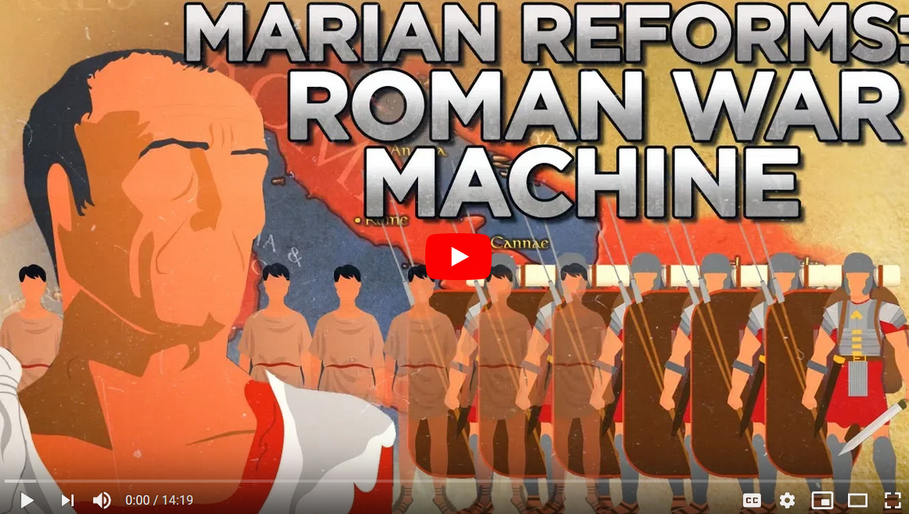
Let’s Watch
Video available on Connect
https://www.youtube.com/watch?v=UIRS_PMeVVY

Slide 9
Roman Military – Before Marius
Part-time citizen army
Soldiers were conscripts from small farms who were called up to fight when necessary
Soliders provided their own armour
Those soldiers with little or no property were only called up in crisis. The state paid for their armour in this case.
With conflicts on the rise around all Roman territories, this system was proving inadequate

Slide 10
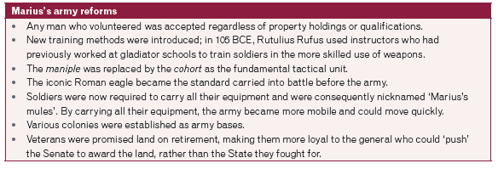
Military Reforms: Marius

Slide 11
Summary
Through his military reforms, Gaius Marius enabled later generals to capitalise on the loyalty their legions had for them personally, rather than to the Republic.

Slide 12
Marius’s Career
Marius was a novus homo and his political career was a lot harder to establish than his military career.
Novus Homo:
Latin for ‘new man’; applied to men who were the first in their family to serve as consul
The definition later widened to include the first men in a family to serve the Senate
Won the magistracy roll as Tribune of the Plebs in 119 BCE followed b the governorship of Hispania Ulterior

Slide 13
Marius’s Career
Political prospects improved when in married Julia Maria, a patrician woman.
Elected consul in 107 BCE and convinced the Senate to grant him the command against Jugurtha, King of Numidia
Marius swiftly brought a war that dragged on against Jugurtha to an end
Marius led additional military victories over the Germanic Cimbri and Teutones
These successes led to Marius being consul for five consecutive years between 104 and 100 BCE.
Due to consuls not usually serving successive terms and Marius being give the rule demonstrates the power and authority he held over both the Senate and People of Rome.

Slide 14

Marius’s Downfall
Task:
Answer the below questions using the Ancient History Encyclopaedia article on Connect and one other source of your choice.
Identify and explain the impact of two major changes that took place during the career of Gaius Marius (133–87 BC).
Identify and explain Marius’s downfall as a leader.

Slide 15
Sources:
Barrie, Alan., Cocks, M., et al. (2019). Senior Ancient History for Queensland. Cambridge University Press.
Conti, Leo., Easton, M., et al. (2016). Oxford Big Ideas Humanities and Social Sciences Western Australian Curriculum 7. Oxford University Press.

